Slide 1

Session 1. Sudden Cardiac Death: Risk Stratification and Management
Appropriate Timing of ICD for The Primary Prevention:
What’s The Optimal Duration of Medications, Including ARNI?
삼성서울병원
김주연

Slide 2
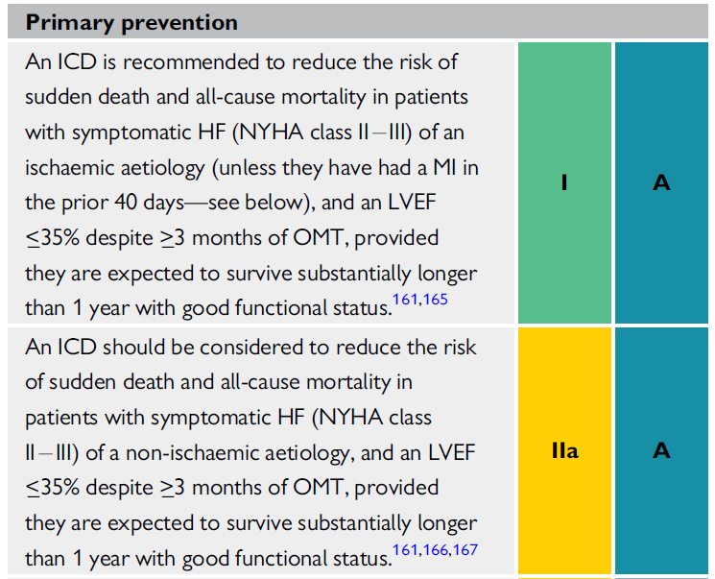

Slide 3
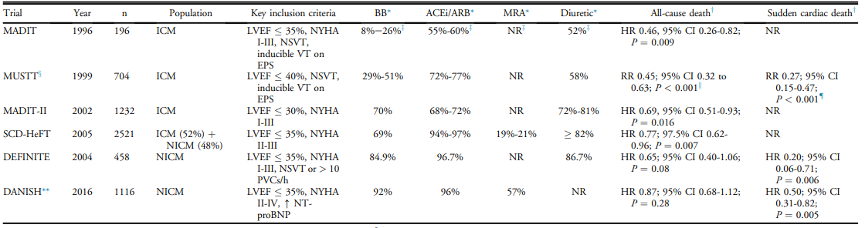
Key primary prevention ICD RCTs

Slide 4
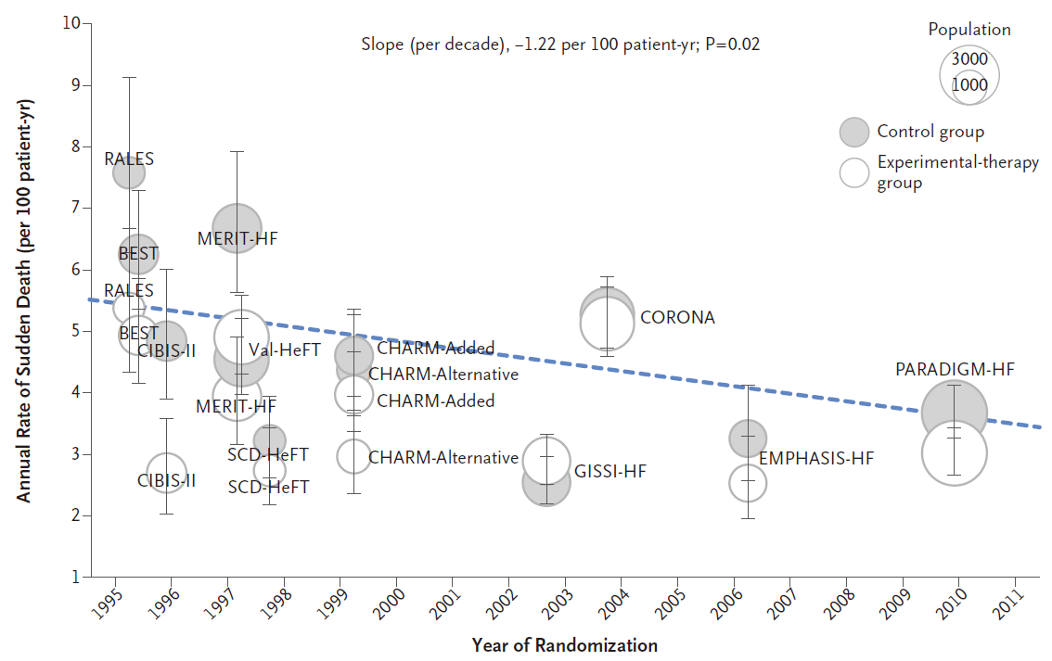
SCD risk has been decreased as drug therapy
Shen L, et al. N Engl J Med 2017 Jul 6;377:41-51.

Slide 5
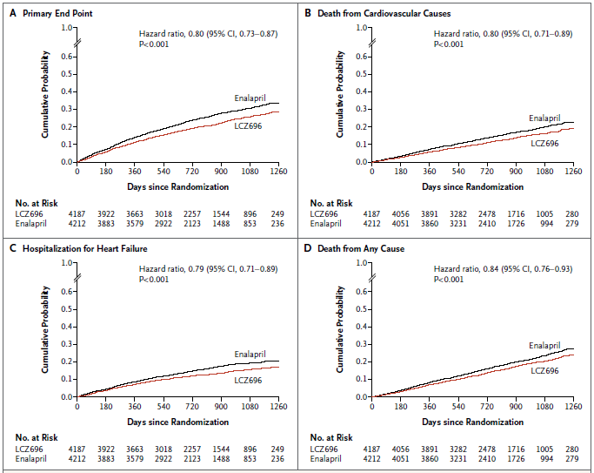
PARADIGM HF: ARNI reduced Hard outcome
N=8,442 patients with CHF
[NYHA Class II–IV with LVEF ≤40%]
and elevated BNP)
Primary outcome:
CV death or HF hospitalization
McMurray, et al. New Engl J Med. 2014;371:993-1004

Slide 6
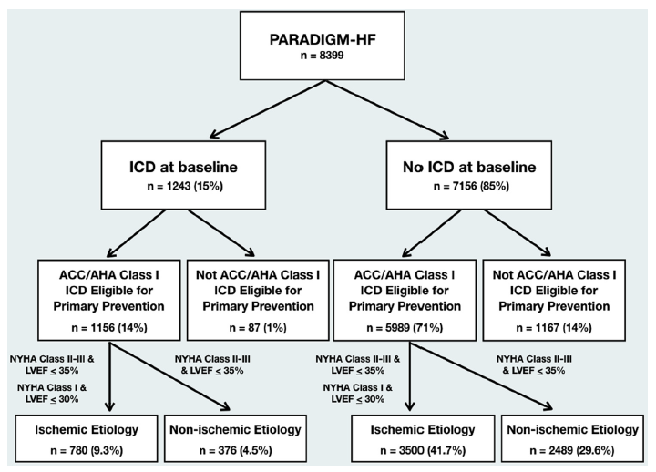
Study Flowchart
PARADIGM-HF (post hoc analysis)
JACC Heart Fail. 2020 Oct;8(10):844-855
Notes:
The magnitude of the treatment effect on sudden death did not differ amongst patients with (36 of 561 sudden deaths) and without (525 of 561 sudden deaths) an implantable defibrillator (HR in those with an ICD 0.49 (95% CI 0.25–0.98); HR in those without an ICD 0.82 (95% CI 0.69–0.98, interaction P = 0.17)
Abbreviations:
CI, confidence interval; CRT-D, Cardiac Resynchronization Therapy-Defibrillator; HFrEF, heart failure with reduced ejection fraction; ICD, implantable cardioverter defibrillator; Sac/val, sacubitril/valsartan
References:
McMurray et al. Eur J Heart Fail 2013;15:334-41
Desai et al. Eur Heart J. 2015;36:1990-7
Swedberg et al. Lancet. 2010;376:875-85;
Zannad et al. N Engl J Med 2011;364:11-21

Slide 7
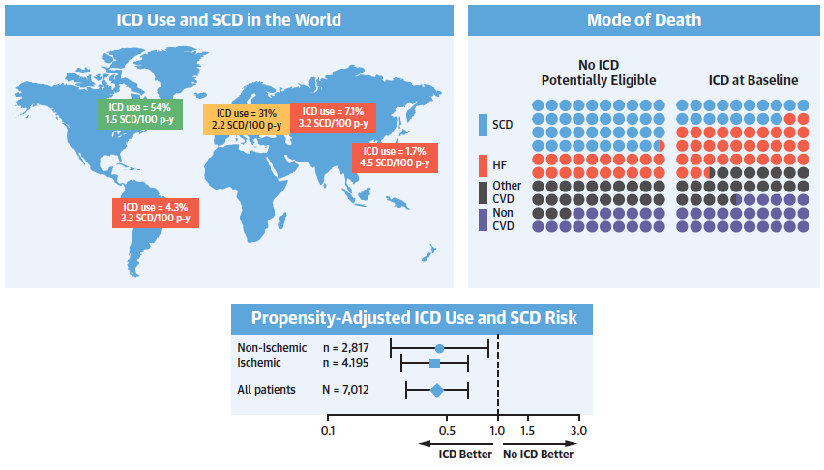
PARADIGM-HF
JACC Heart Fail. 2020 Oct;8(10):844-855

Slide 8
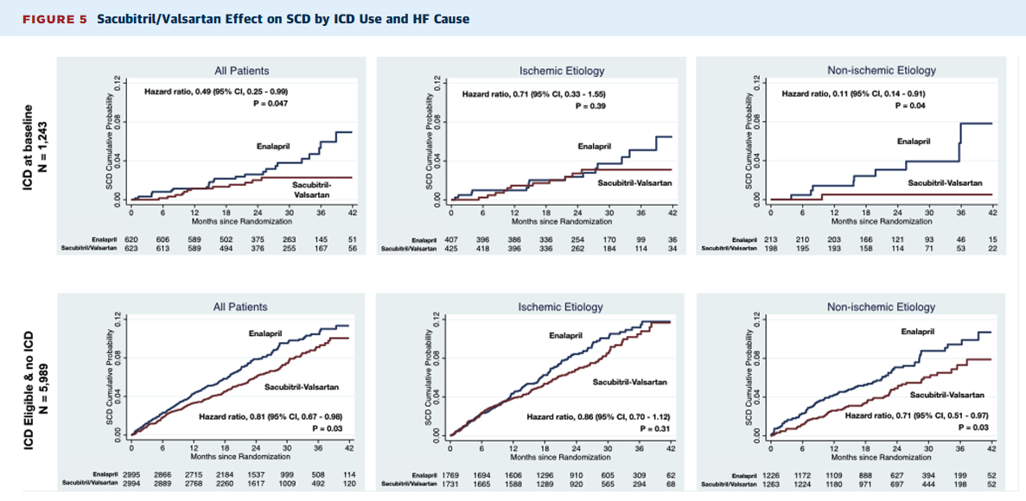
JACC Heart Fail. 2020 Oct;8(10):844-855

Slide 9
DAPA-HF
Dapagliflozin reduced the risk of any serious ventricular arrhythmia, cardiac arrest, or sudden death when added to conventional therapy in patients with HFrEF
European Heart Journal (2021) 42, 3727–3738

Slide 10
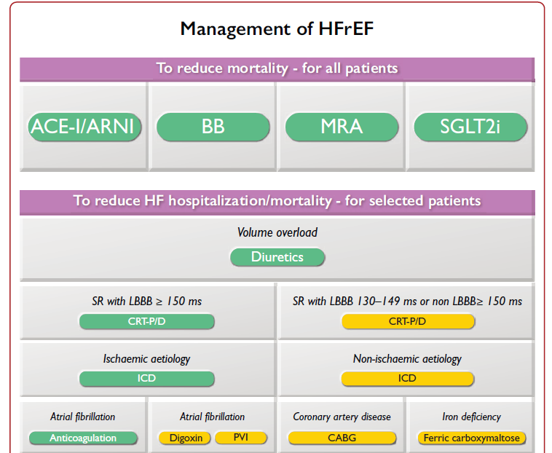

Slide 11
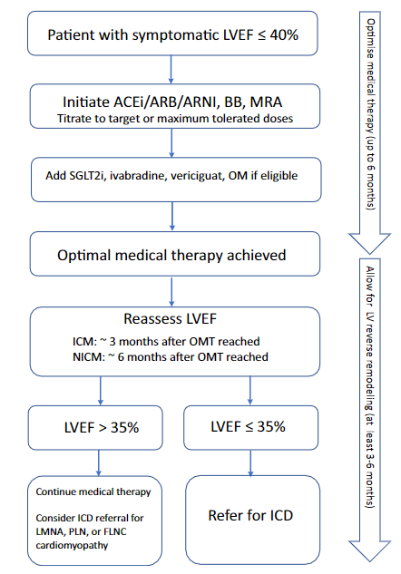
ICMP vs NICM

Slide 12
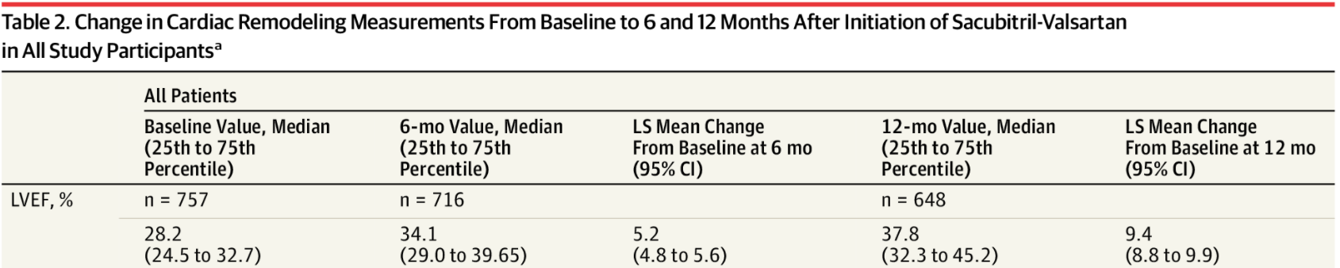
PROVE-HF
JAMA. 2019;322(11):1085-1095. doi:10.1001/jama.2019.12821

Slide 13
Competing Risk of SCD
High risk of SCD such as ICM
High risk of non-SCD
  Older age
  Higher burden of comorbidities
  HYHA class III-IV
Competing risk of SCD 가 높지 않다면 OMT 6months 까지 기다려 볼 수…..

Slide 14
Summary
As medical therapy continues to evolve, the risk of SCD is decreasing
Timing of ICD implantation
  LVEF less than 35% despite OMT for a minimum of 3months
  OMT = achievement of maximum well tolerated dose
  Risk stratification of SCD vs nonsudden cardiac death

Slide 15
감사합니다
Thank you!

